Slide 1
Managing Innovation and Fostering Corporate Entrepreneurship
Strategic Management Part 3 - Strategic Implementation
BUS 4750
Instructor: Dr. Xiaodan “Abby” Wang
Western Michigan University

Slide 2

QUESTION
According to the text, effective leadership is like a three-legged stool consisting of all of the following except B. nurturing a culture dedicated to excellence and ethical behavior. C. determining a direction. D. designing the organization.
A. dedication to maintaining the status quo.
Notes:
2

Slide 3
QUESTION
All of the following constitute organizational bases of a leader's power except A. legitimate power. B. reward power. D. coercive power.
C. referent power.
Notes:
3

Slide 4
QUESTION
The three broad sets of capabilities that a leader should possess include all of the following except A. technical skills. B. cognitive abilities. D. emotional intelligence.
C. calculative abilities.
Notes:
4

Slide 5
QUESTION
Which of the following is NOT a characteristic of a successful learning organization? A. They create a proactive, creative approach to the unknown. B. They actively solicit the involvement of employees at all levels.
D. They enable everyone to use their intelligence and apply their imagination.
C. They regularly engage in activities to reinforce the status quo.
Notes:
5

Slide 6
Managing Innovation
Innovation involves using new knowledge to transform organizational processes or create commercially viable products and services
Innovation occurs when _________________________ ______________________
Sources of new knowledge
Latest technology
Results of experiments
Creative insights
Competitive information

Slide 7
Example
Some Companies, such as Apple, are always innovating popular products, while others are constantly struggling for their one great idea.
There are “five disciplines” for creating what customers want
Identify important customer needs
Create solutions that fill those needs
Build innovation teams
Empower "innovation champions" who keep the effort on track
Align the entire enterprise around creating value for customers

Slide 8
Types of Innovation
Degree of innovativeness
Radical innovation
Fundamental changes and breakthroughs
Evoke major departures from existing practices
Can be highly disruptive
Can transform or revolutionize a whole industry
Incremental innovation
Enhance existing practices
Small improvements in products and processes
Evolutionary applications within existing paradigms
Notes:
In terms of degree of innovativeness, we can divide innovation into radical innovation and incremental innovation.

Slide 9
Continuum of Radical and Incremental Innovations
Fiber-optic cable
Internet browser
Online auction exchanges
Bubble wrap
Radical Innovation
Incremental Innovation
Laparoscopic “keyhole” surgery
Speech recognition software
Polyester
Enterprise resource planning (ERP)
Frozen yogurt

Slide 10
Types of Innovation
Product and process innovations
Product innovation
Refers to efforts to create product designs and applications of technology to develop new products for end users
More radical and common during common of an industry’s life cycle
Associated with differentiation strategies

Slide 11
Types of Innovation
Product and process innovations
Process innovation
Associated with improving the efficiency of an organizational process, especially manufacturing systems and operations
Firms can
Improve materials utilization
Shorten cycle time
Increase quality
More likely to occur in later stages of an industry’s life cycle
Associated with leadership strategies

Slide 12
Challenges of Innovation
Seeds versus weeds
Experience versus initiative
Internal versus external staffing
Building capabilities versus collaborating
Incremental versus preemptive launch

Slide 13
Defining the Scope of Innovation
Firms must define the “strategic envelope” (scope of the innovation efforts)
In defining the strategic envelope, a firm should answer several questions
How much will the innovation cost?
How likely is it to actually become commercially viable?
How much value will it add; that is, what will it be worth if it works?
What will be learned if it does not pan out?

Slide 14
Managing the Pace of Innovation
Firms need to regulate the pace of innovation
Incremental innovation
May be six months to two years
May use a milestone approach driven by goals and deadlines
Radical innovation
Typically long term – 10 years or more
Often involves open-ended experimentation and time-consuming mistakes
Strict timelines unrealistic

Slide 15
Collaborating with Innovation Partners
Innovation often requires collaborating with others who possess complementary knowledge and skills
Partners can come from several sources
Other personnel within the department
Personnel within the firm but from another department
Partners outside the firm
Non-business sources, including research universities and the federal government

Slide 16
Corporate Entrepreneurship
Two primary aims:
Pursuit of new venture opportunities
Strategic renewal
Blue Ocean vs. Red Ocean
Companies that are willing to venture into market spaces where there is little or no competition – labeled “blue oceans” – will outperform those firms that limit growth to incremental improvements in competitively crowded industries – labeled “red oceans”

Slide 17
Corporate Entrepreneurship – Two Approaches
Focused approaches
Separate the corporate venturing activity from the other ongoing operations of the firm
Corporate entrepreneurship is usually the domain of autonomous work groups that pursue entrepreneurial aims independent of the rest of the firm
Advantage: free entrepreneurial team members to think and act without the constraints imposed by existing organizational norms and routines.
Disadvantage: isolate from the corporate mainstream, may fail to obtain the resources or support needed

Slide 18
Corporate Entrepreneurship – Two Approaches
Types of focused approaches
New venture groups
Goal is to identify, evaluate, and cultivate venture opportunities
Typically function as semi-autonomous units with little formal structure
Business incubators
Designed to “hatch” new businesses
Provide five functions: 1) funding, 2) physical space, 3) business services, 4) mentoring and 5) networking

Slide 19
Corporate Entrepreneurship – Two Approaches
Dispersed approaches
A dedication to the principle and practices of entrepreneurship is spread throughout the organization
Two related aspects: entrepreneurial cultures and product champions
Advantages:
Organizational members don’t have to be reminded to think entrepreneurially or be willing to change (the ability to change – core capability)
Stakeholders can bring new ideas or venture opportunities to anyone in the organization and expect them to be well-received
Disadvantage:
Firm may feel they must change for the sake for change, causing them to lose vital competencies or spend to much on R&D

Slide 20
Entrepreneurial Orientation
EO refers to the strategy-making practices that businesses use in identifying and launching corporate ventures
Represents a frame of mind and a perspective toward entrepreneurship that is reflected in a firm’s ongoing processes and corporate culture
Has five dimensions

Slide 21
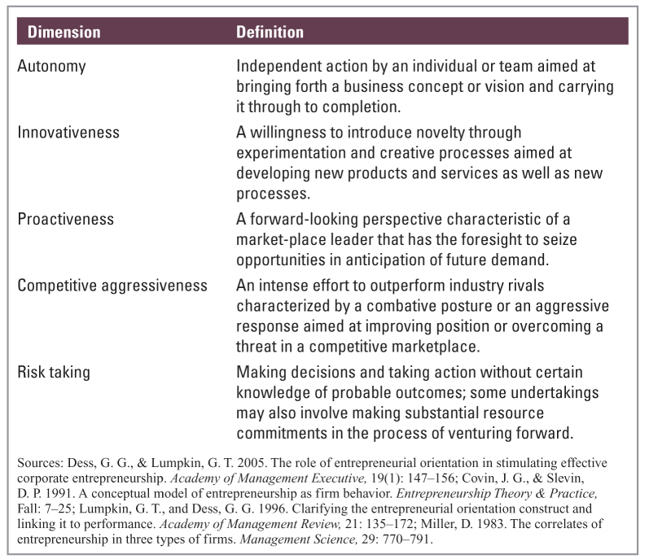
Entrepreneurial Orientation

Slide 22
Entrepreneurial Orientation
Autonomy
Two techniques often used to promote autonomy
Using skunkworks to foster entrepreneurial thinking
Designing organization structures that support independent action
Innovativeness
Two methods used to enhance competitive position through innovativeness
Fostering creativity and experimentation
Investing in new technology, R&D, and continuous improvement

Slide 23
Entrepreneurial Orientation
Proactiveness
Two methods to promote acting proactively
Introducing new products or technological capabilities ahead of the competition
Continuously seeking out new product or service offerings
Competitive aggressiveness
Two ways competitively aggressive firms enhance their entrepreneurial position
Entering markets with drastically lower prices
Finding successful business models and copying them.

Slide 24
Entrepreneurial Orientation
Risk taking
Three types of risks faced by organizations and their executives
Business risk taking
Financial risk taking
Personal risk taking
Two methods to strengthen competitive position through risk taking
Researching and assessing risk factors to minimize uncertainty
Using techniques that have worked in other domains

Slide 25
Example
A design thinking approach can help you deal with risk.
Here are seven ways to get started:
Cultivate an unreasonable obsession with desirability
Become more comfortable acting on your informed intuition
Prototype, prototype, prototype
Think big, but start small(er)
Treat money as a positive constraint
Make a list of the best things that could happen
Seek challenges

